Slide 1



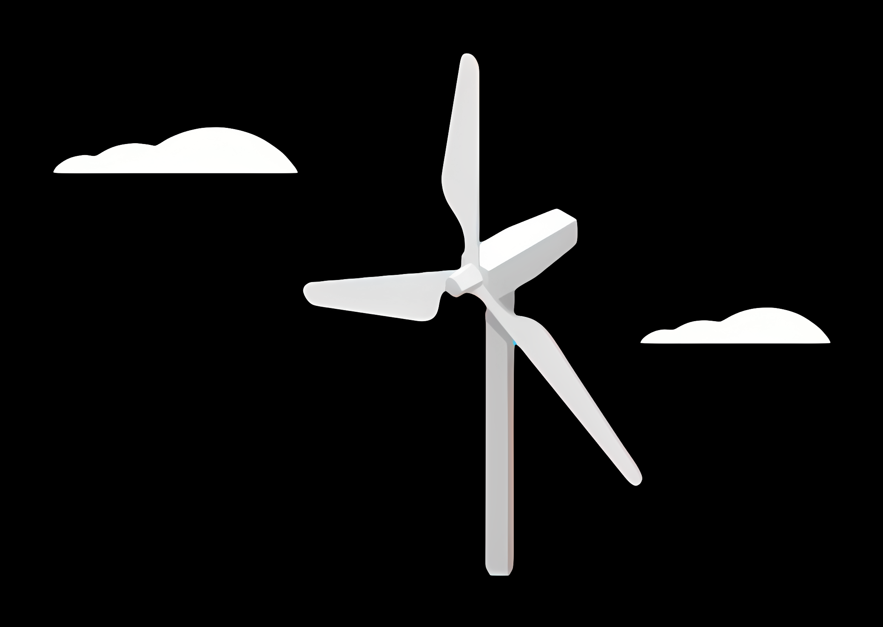
Weekly Presentation: Rotor Bearing System
Week number : 02
Date: 30/09/2025
Supervisor: Prof. Quell
Group members: Divyesh Mistry, Venkata Sreekanth .K , Sreehari Padachery, Jill Sadariya

Slide 2
Journal bearing
A journal bearing is a type of plain bearing that supports a rotating shaft and allows it to turn smoothly with minimal friction.
The part of the shaft that rests inside the bearing is called the journal, which is why it’s named a journal bearing.
It doesn’t use rolling elements (like balls or rollers); instead, it works on sliding contact.
Typically, a thin film of lubricant (oil or sometimes air) separates the shaft from the bearing surface, preventing direct metal-to-metal contact.
The load from the shaft is distributed over the surface of the bearing, making it suitable for heavy loads and high-speed applications.

Slide 3
Why Journal bearing over Roller bearing ?
Aspect | Roller Bearings (Case-1) | Journal Bearings (Case-2)
High-speed shaft vibrations | Higher vibrations | Lower vibrations (better damping)
Gear tooth forces (sub-rated speeds) | Lower gear forces | Higher gear forces (fluid film effect)
Gear reliability | Normal reliability | Risk of reduced reliability (higher stresses)
Bearing life | Limited (fatigue failures) | Theoretically infinite life
Load capacity (same dimensions) | Lower load capacity | Higher dynamic & static load capacity
Size & Scalability | Difficult for (main shafts > 2 meters). | Easy to Manufacture
Cost | Higher cost | Less cost
Long Life and Reliability | Often fail due to surface fatigue, micropitting, and grease limitations | With proper lubrication, journal bearings can last decades.

Slide 4
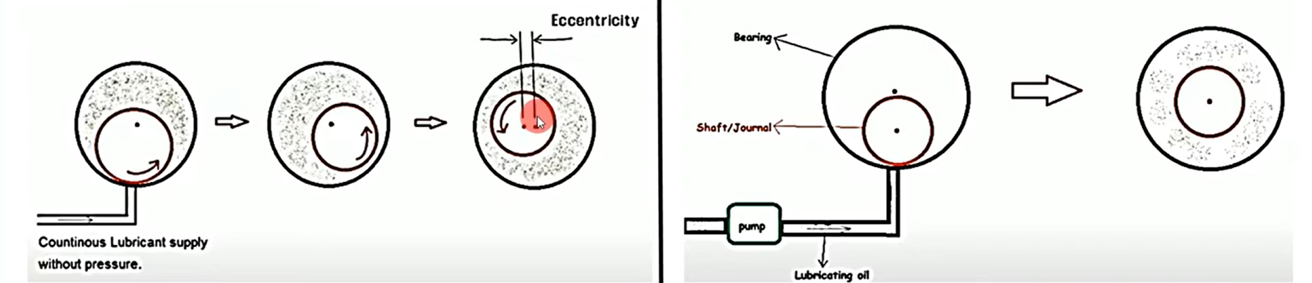
Types of Journal bearing
Based on Lubrication Principle
Hydrodynamic Journal Bearing
Hydrostatic Journal Bearing
Boundary Lubricated Bearing
2. Based on Bearing Surface Geometry
Plain (Sleeve) Bearing
Lobed Bearings
Tilting Pad (Pivoted Pad) Bearing
Fig. 1. Hydrodynamic Journal Bearing vs Hydrostatic Journal bearing

Slide 5
Cost factors
Factor | Roller Bearing | Journal Bearing
Capex (Capital Cost) | High (manufacturing precision, complex design, expensive for large sizes) | Lower (simpler design, cheaper for large shafts)
High Serviceability | Easy to replace (standardized sizes, quick maintenance) | More complex (requires skilled service, oil system maintenance)
Opex (Operating Cost) | Higher (grease replacement, frequent failure risk under heavy load) | Lower (long life with proper lubrication, less frequent replacement)
Material | High-grade alloy steel (expensive, wear-resistant) | Babbitt, bronze, or white metal lining (cheaper and widely available)
Transport Limit | Limited by size (large roller bearings are bulky, costly to transport) | Easier to scale (journal bearings can be split type, easier to transport and assemble)

Slide 6
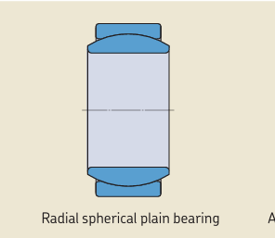
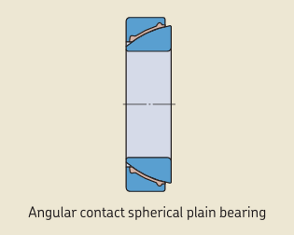
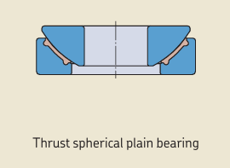
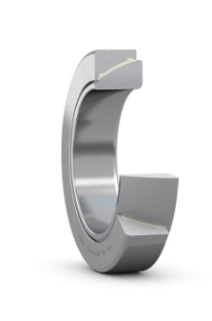
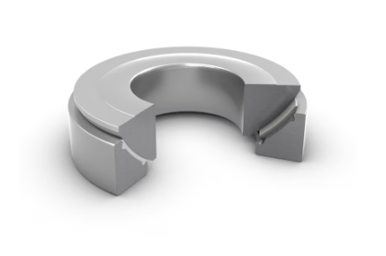
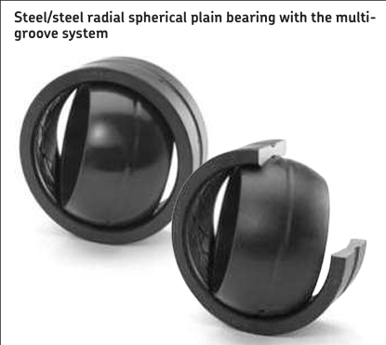
Types of spherical Journal bearing
Source: SKF

Slide 7
Radial Spherical Plain Bearings
Inner ring rotates inside the outer ring.
Designed mainly for radial loads (like a journal bearing, but with spherical misalignment capability)
Angular Contact Spherical Plain Bearings
Inner & outer rings designed so that the contact angle carries combined radial + axial loads.
Thrust Spherical Plain Bearings
Only designed for axial loads (thrust direction).

Slide 8
References
Decker, T., Jacobs, G., Röder, J. et al. Experimental study on the condition monitoring of planetary journal bearings in wind turbine gearboxes using the surface acoustic wave method. Forsch Ingenieurwes 89, 112 (2025). https://doi.org/10.1007/s10010-025-00887-y
Sajid, Z. (n.d.). Tilting pad. Scribd. https://www.scribd.com/document/417450883/Tilting-Pad
Prof. Peter Quell Lecture Notes.

Slide 9
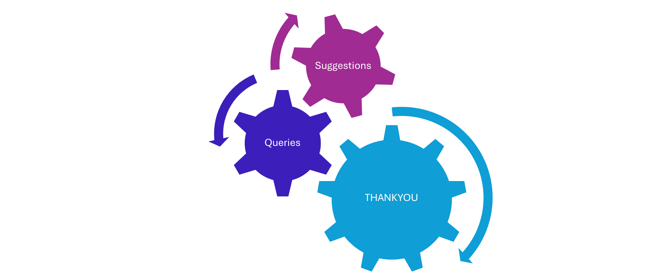

Slide 10
For detailed discussion with Professor

Slide 11
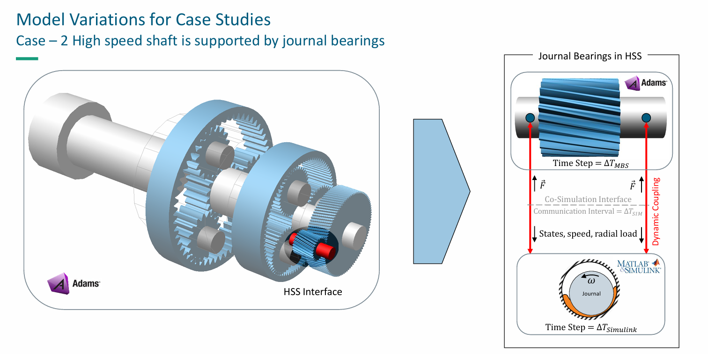
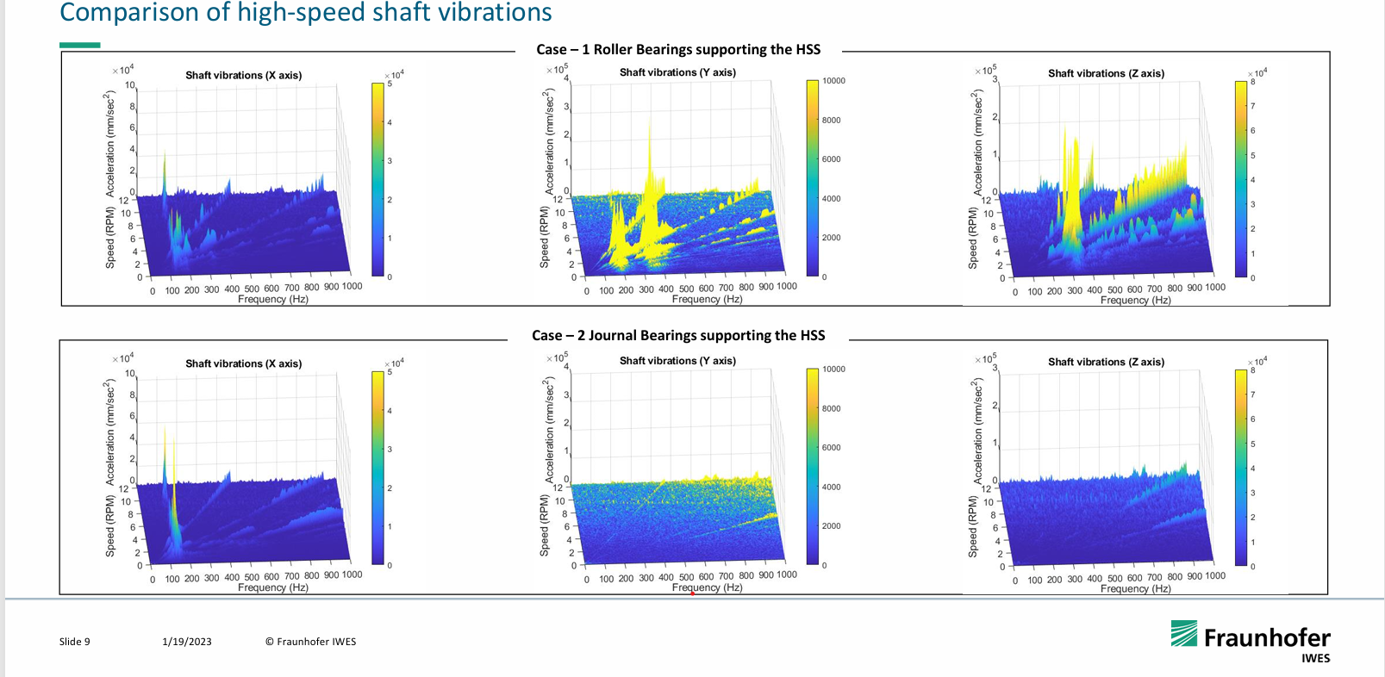
Multi-Body System model (MBS)
It is a simulation model where the drivetrain is represented as a collection of rigid and flexible bodies (shafts, gears, bearings) connected by joints and force elements.

Slide 12
Main shaft (low-speed shaft) : Carries rotor torque into gearbox.
Planetary gear stage : Main shaft drives the planet carrier.
Intermediate-speed gear stages : Parallel shaft gears increase speed step by step.
High-speed shaft (HSS) :Connects final gear stage to generator.
5 MW Reference Drivetrain (NREL) is used
Does not mention the exact type of journal bearing, assuming Plain short journal bearing (cylindrical) was used as the replacement for the roller bearings.

Slide 13

Comparison of High speed shaft vibrations

Slide 14
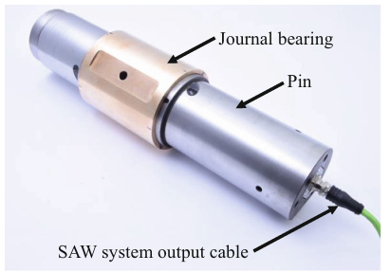
1. Cylindrical (standard) hydrodynamic journal bearings
Used in studies on planetary gear stages (called Planetary Journal Bearings – PJBs / PGJBs).
E.g. Decker et al. (2025) tested cylindrical journal bearings in planetary stages with SAW sensors for monitoring.
Fig. 1 a Photograph of the planetary journal bearing (PJB) on the pin with integrated SAW measurement setup

Slide 15

ORE Catapult is using its expertise in the wind turbine bearing area to conduct a feasibility study and demonstration of HJB (Hydrodynamic journal bearings) on the main-shaft of an offshore wind turbine in order to enhance main-shaft-bearing reliability.
No photos or information available

Slide 16
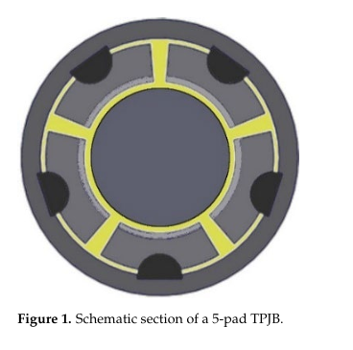
2. Hydrodynamic tilting-pad journal bearings
Mentioned in broader turbine drivetrain research (e.g. SINTEF & ORE Catapult projects).
Tilting pads improve stability against oil whirl/whip at variable speeds.

Slide 17
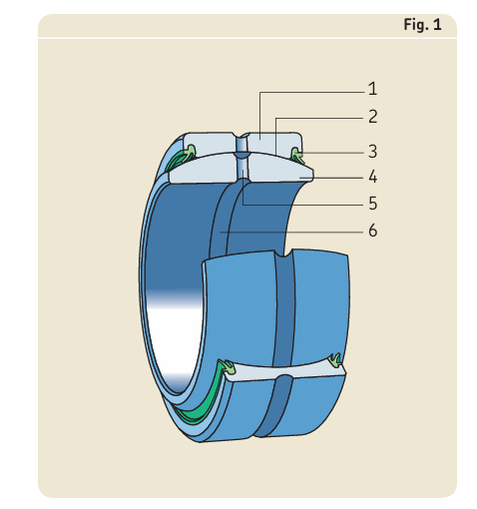
Bearing terminology
Spherical plain bearing
Outer ring
Sliding contact surfaces
Seal
Inner ring
Lubrication hole
Lubrication groove
Source: SKF

Slide 18
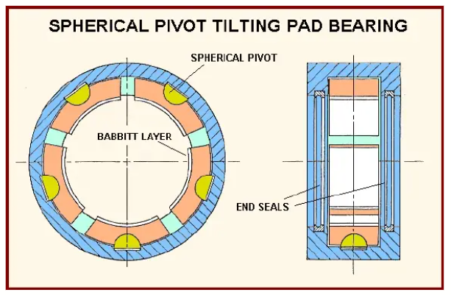
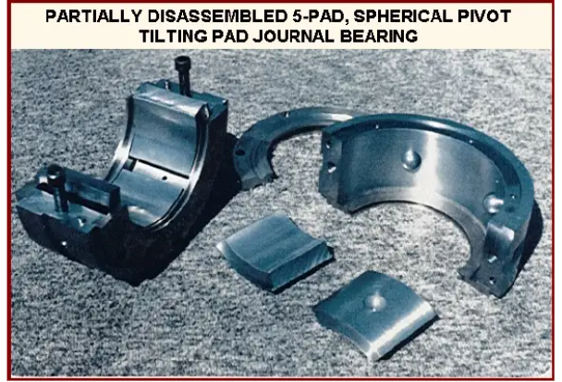
Source: Reference [2]

Slide 19
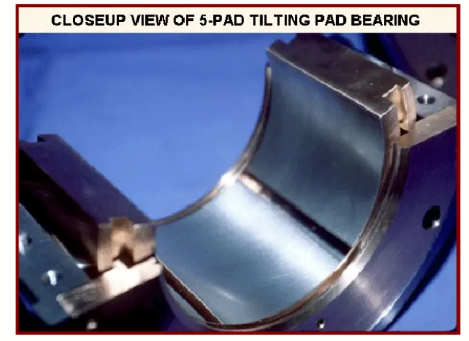
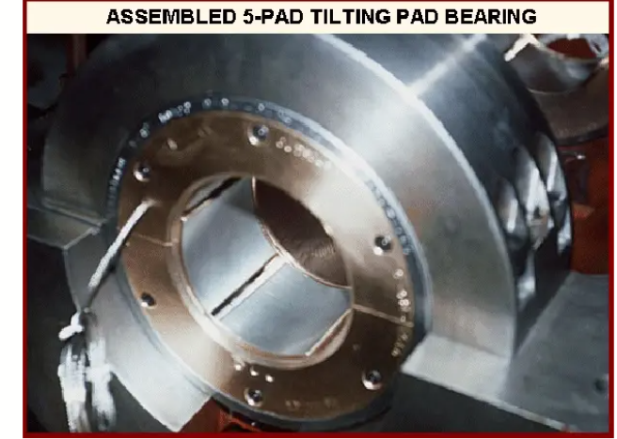
Source: Reference [2]

Slide 20
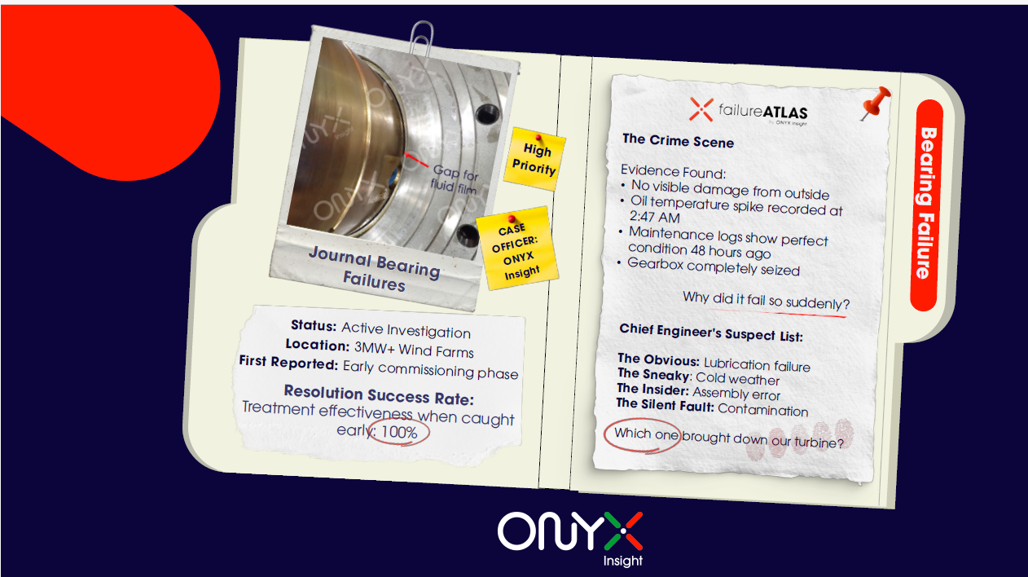
Journal bearing Failures in Wind Turbine

Slide 21
